Slide 1
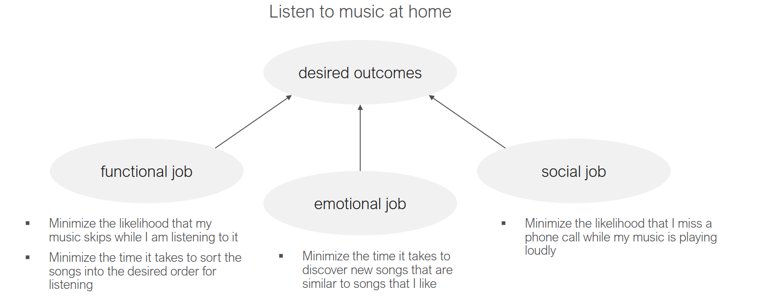
Jobs to be done. – about a customer making progress toward a desired futured.

Slide 2



Jobs to be done.
Job Statement. – Find new novels to read in my leisure time.
Desired outcome.
Functional job.
Be able to suggest the novel that I prefer.
Prioritize top 10 novels that I might select from my history.
Minimize the time it takes to change the screen size and screen background mode.
Minimize the time it takes to jump to where I left off.
Emotional job.
Minimize the time it takes to discover new novels that are similar to novel that I like.
Social job.
Minimize the likelihood that I miss a contact from my social media.
Minimize the time it takes to share and review my favorite novels to others.

